Slide 1
BIOS27816: Population biology of infectious diseases of global health concern
Transmission dynamics and interventions to control zoonotic diseases
UChicago Center in Paris
Paris, France
January 2024

Slide 2
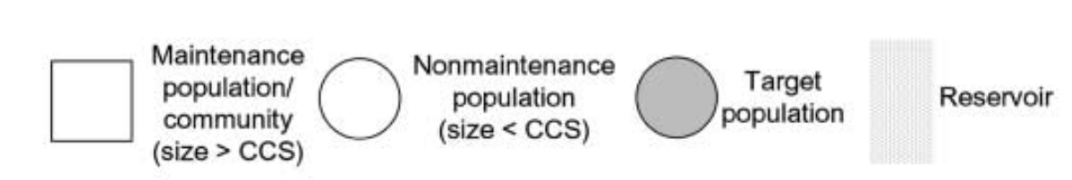
Defining terms in multi-species infections…
Haydon et al. 2002. EID.
Lembo et al. 2008. J of Animal Ecology.

Slide 3
Defining terms in multi-species infections…
population of interest to the study
population[s] sourcing pathogen to target population
Haydon et al. 2002. EID.
Lembo et al. 2008. J of Animal Ecology.

Slide 4
Defining terms in multi-species infections…
spillover hosts only
population of interest to the study
population[s] sourcing pathogen to target population
population can sustain endemic transmission of pathogen
Haydon et al. 2002. EID.
Lembo et al. 2008. J of Animal Ecology.

Slide 5
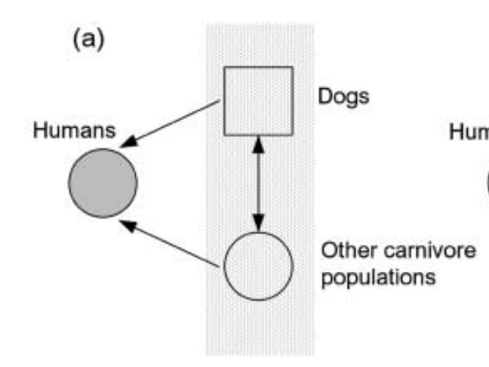
Defining terms in multi-species infections…
Haydon et al. 2002. EID.
Lembo et al. 2008. J of Animal Ecology.

Slide 6


spillover
reservoir host
spillover host
transmission
(can occur directly or via vector)
Spillover occurs when a pathogen transmits from one species host to another
Notes:
Emerging infectious diseases can be defined as infectious diseases that have newly appeared in a population or have existed but are rapidly increasing in incidence or geographic range, or that are caused by one of the NIAID Category A, B, or C priority pathogens.

Slide 7
zoonosis
reservoir host
spillover host
transmission
(can occur directly or via vector)
Over 60% of all ‘emerging’ infectious diseases are zoonotic,
meaning transmitted from an animal reservoir to a human host.
(Emerging infectious have newly appeared or are increasing in incidence or geographic range, or caused by NIAID priority pathogens)
Notes:
Emerging infectious diseases can be defined as infectious diseases that have newly appeared in a population or have existed but are rapidly increasing in incidence or geographic range, or that are caused by one of the NIAID Category A, B, or C priority pathogens.

Slide 8
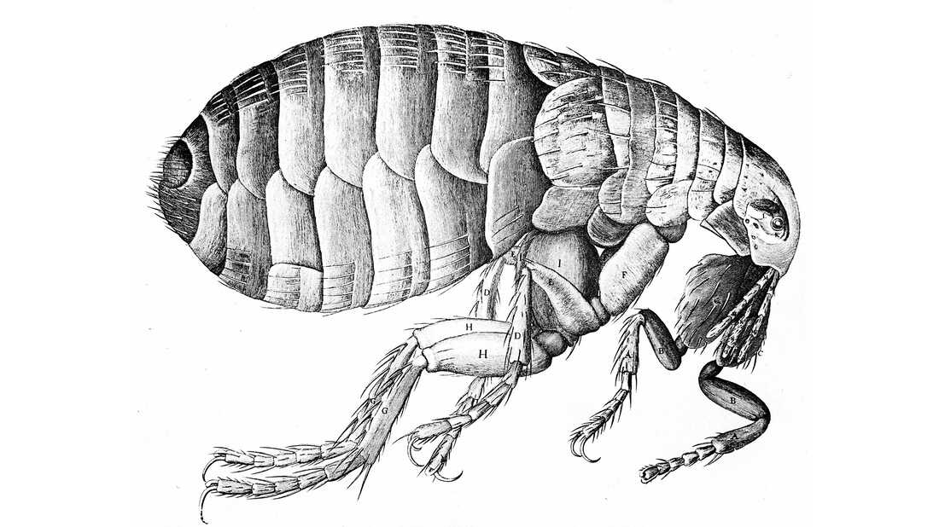
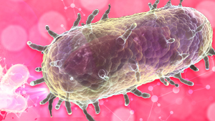
zoonosis
vector
reservoir host
spillover host
transmission
Over 60% of all ‘emerging’ infectious diseases are zoonotic,
meaning transmitted from an animal reservoir to a human host.
Animal hosts are not vectors!

Slide 9


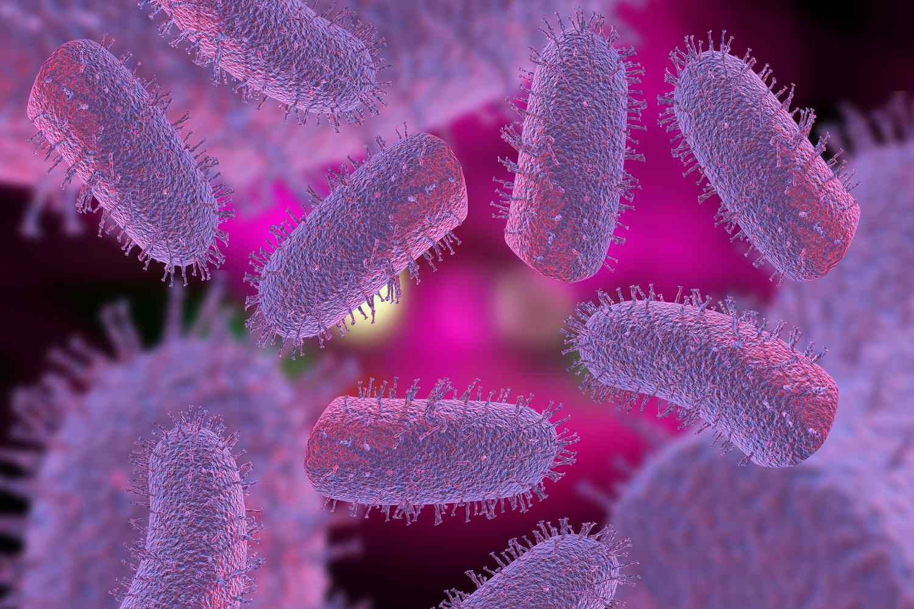


Pathogens can also spillover to alternative wildlife hosts.
reservoir host
spillover hosts
transmission
These pathogens are not considered zoonoses unless they spillover to humans!

Slide 10
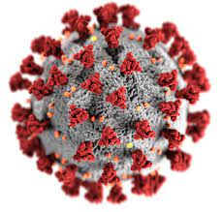
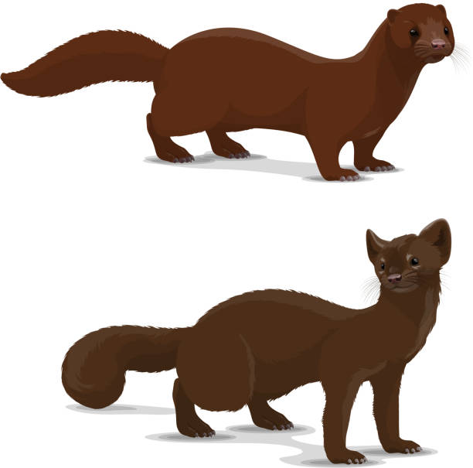
spillback
reservoir host
spillover host
transmission
when pathogens transmit from a spillover host back to the original reservoir host
(example: transmission of SARS-CoV-2 from mink back to humans… interesting case because neither humans nor mink are actually the original reservoir host)
Notes:
Emerging infectious diseases can be defined as infectious diseases that have newly appeared in a population or have existed but are rapidly increasing in incidence or geographic range, or that are caused by one of the NIAID Category A, B, or C priority pathogens.

Slide 11



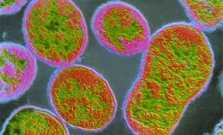
Spillback occurs among wildlife as well
reservoir host
spillover hosts
transmission
cattle
wild ungulate
Cattle sourced Brucella to wild ungulates in Yellowstone National Park, which now serve as a source for reinfection to cattle.
Dobson and Meagher. 1996. Ecology.

Slide 12
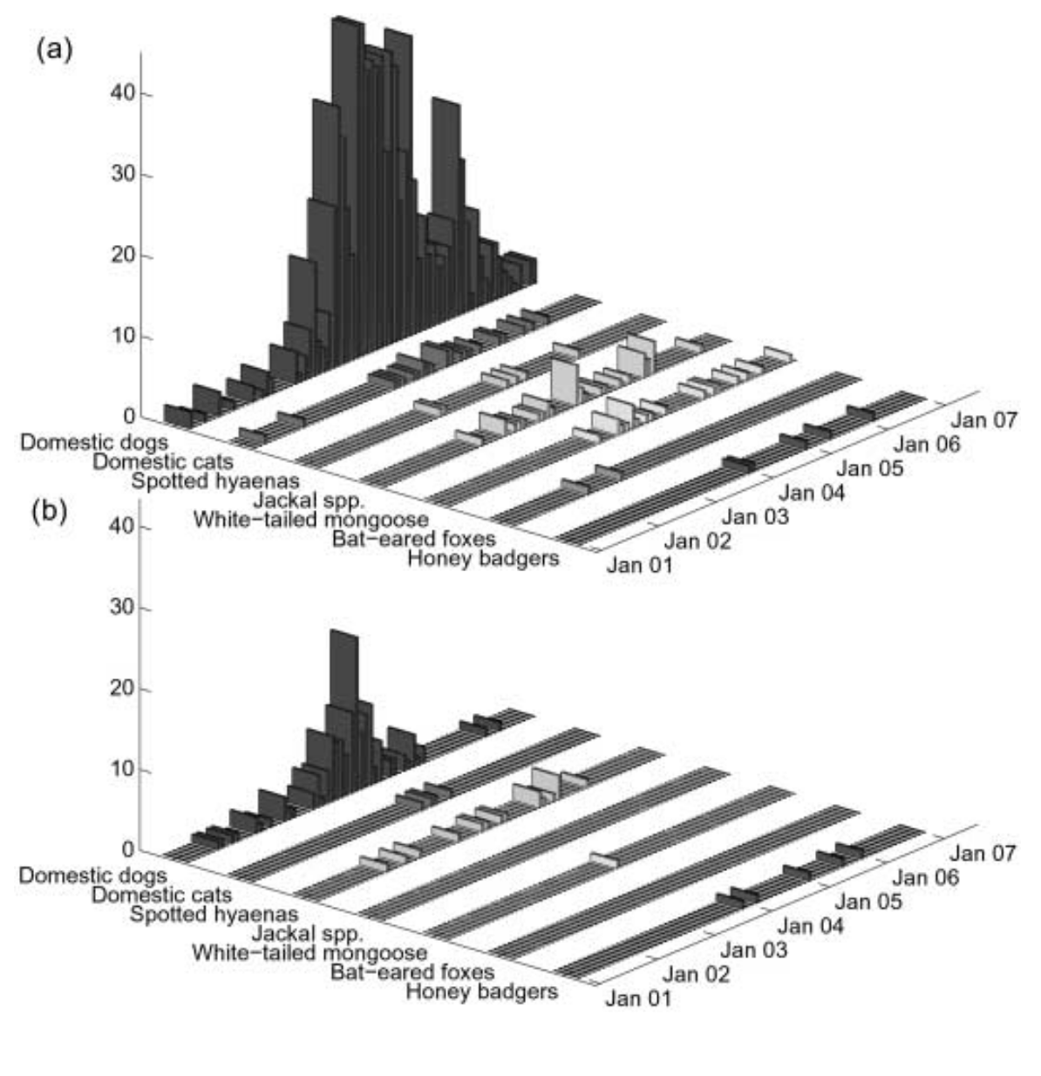
Pathogens can also spillover to alternative wildlife hosts.
Serengeti District, Tanzania
Cases of Rabies
Cases of Rabies
Ngorogoro District, Tanzania
Lembo et al. 2008. J of Animal Ecology.

Slide 13
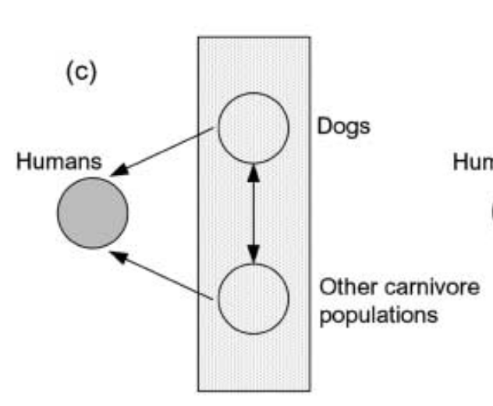
Vaccination of domestic dogs aims to shift the ecology of the system
Haydon et al. 2002. EID.
Lembo et al. 2008. J of Animal Ecology.

Slide 14
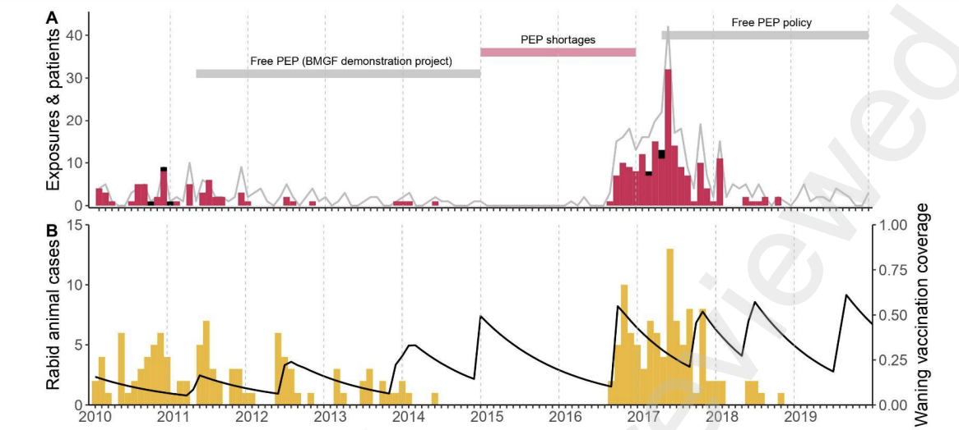
Vaccination of domestic dogs can successfully eradicate rabies from some systems.
dog cases
dog vaccination coverage
Lushasi et al. 2023. eLife.

Slide 15
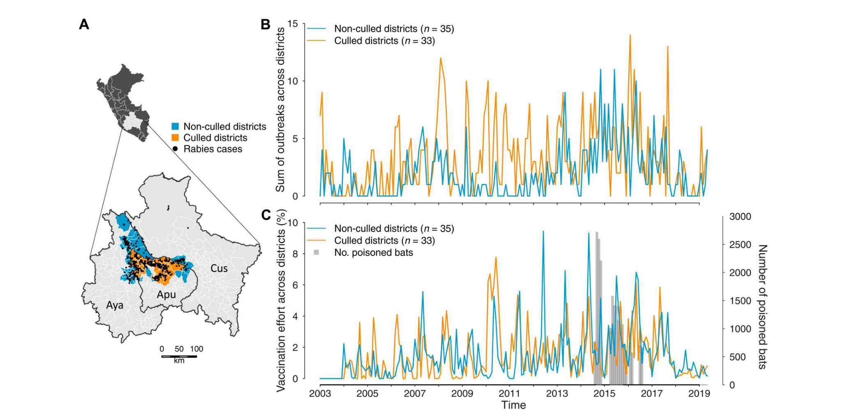
Culling of infected reservoir hosts is typically an ineffective mechanism of disease control: case study bat rabies
Viana et al. 2023. Science Advances.

Slide 16
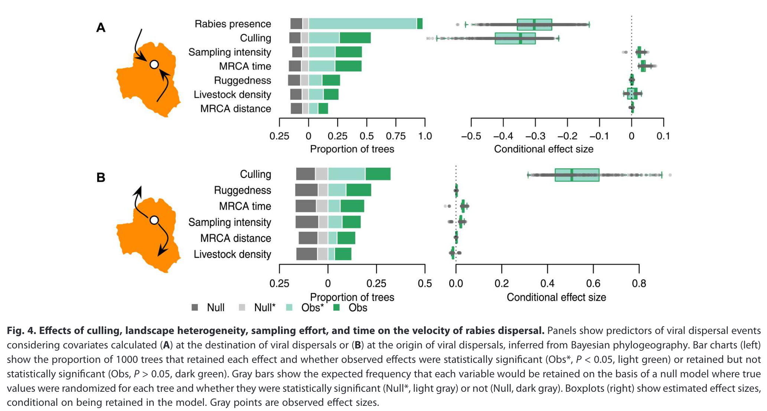
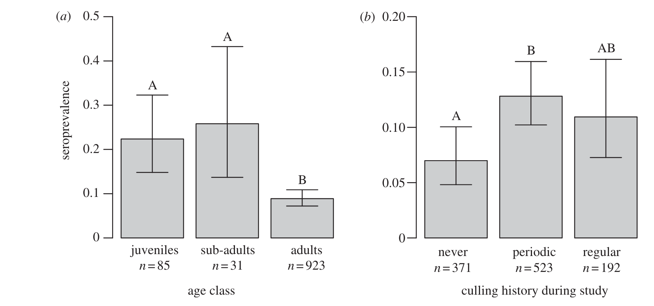
Culling of infected reservoir hosts is typically an ineffective mechanism of disease control: case study bat rabies
Streicker et al. 2012. Proc Soc B.
Viana et al. 2023. Science Advances.

Slide 17
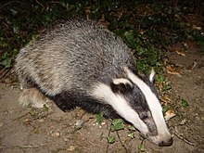
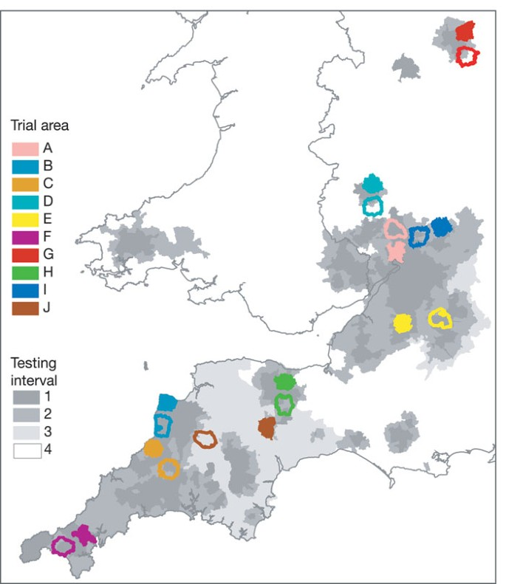
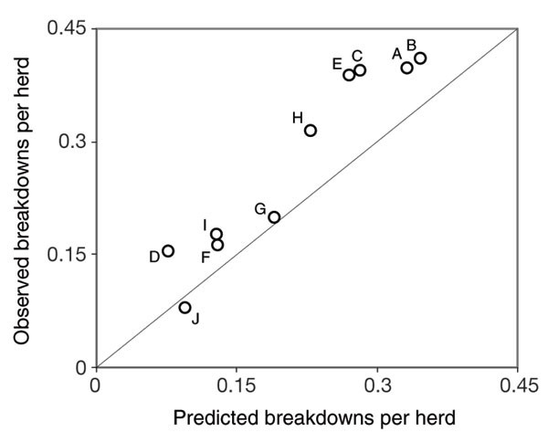
Culling of infected reservoir hosts is typically an ineffective mechanism of disease control: Case study UK badgers and bovine TB
Donnelly et al. 2003. Nature.

Slide 18
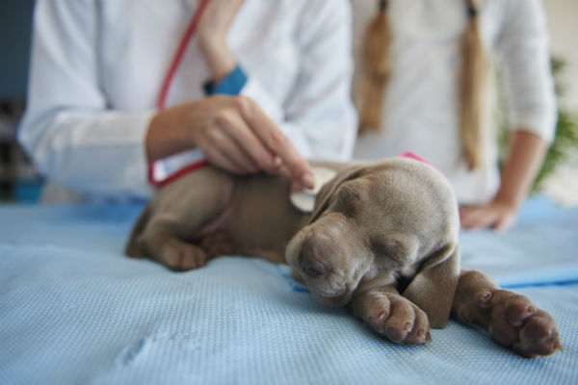
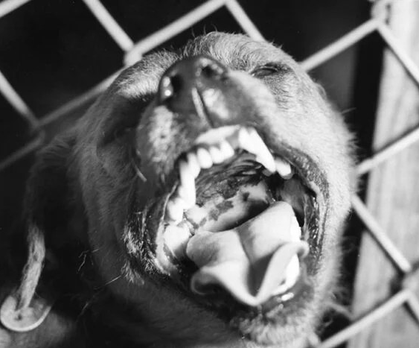
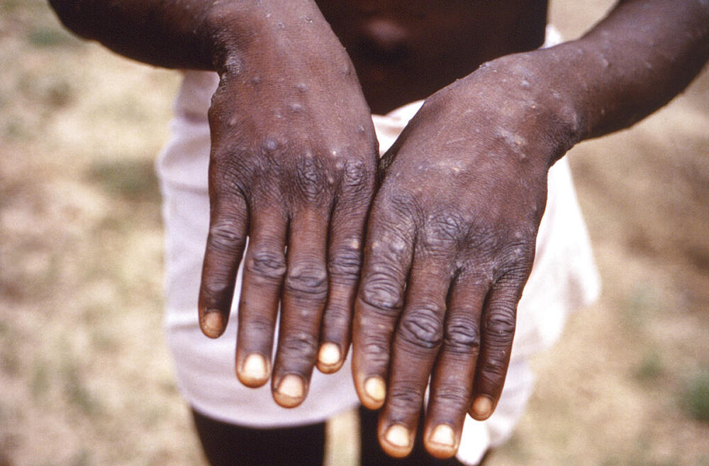
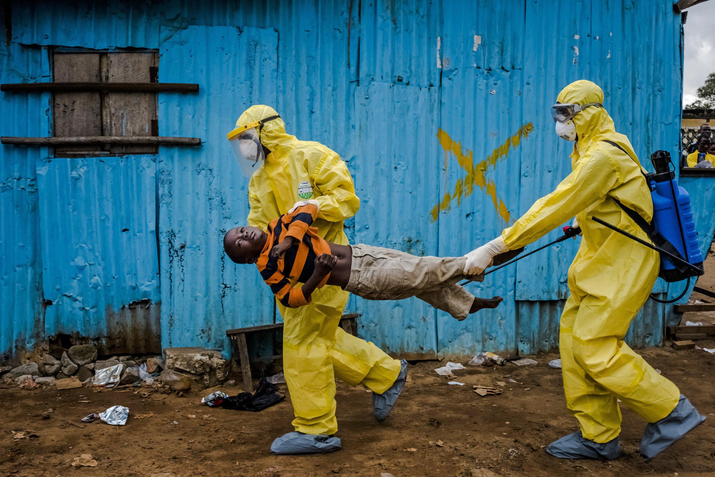
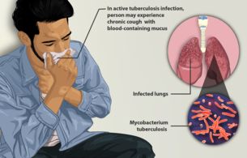
Pathogens can be classed according to their host relationships.
Stage I
Stage II
Stage III
Stage IV
Stage V
Transmits exclusively in humans
Transmits exclusively in animals
Human cases from spillovers only
Stuttering chains of transmission in humans
Sustained transmission and human outbreaks
canine parvovirus
rabies virus
monkeypox (pre-2022)
Ebola virus (especially post-2014)
Tuberculosis
Lloyd-Smith et al. 2009. Science.

Slide 19
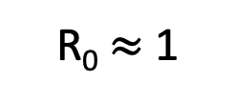
Pathogens can be classed according to their host relationships.
Stage I
Stage II
Stage III
Stage IV
Stage V
Transmits exclusively in humans
Transmits exclusively in animals
Human cases from spillovers only
Stuttering chains of transmission in humans
Sustained transmission and human outbreaks
canine parvovirus
rabies virus
monkeypox (pre-2022)
Ebola virus (especially post-2014)
Tuberculosis
R₀ < 1
R₀ $≈$ 1
R₀ > 1
Zoonotic pathogens can be classed according to their R₀ in humans.
Lloyd-Smith et al. 2009. Science.

Slide 20
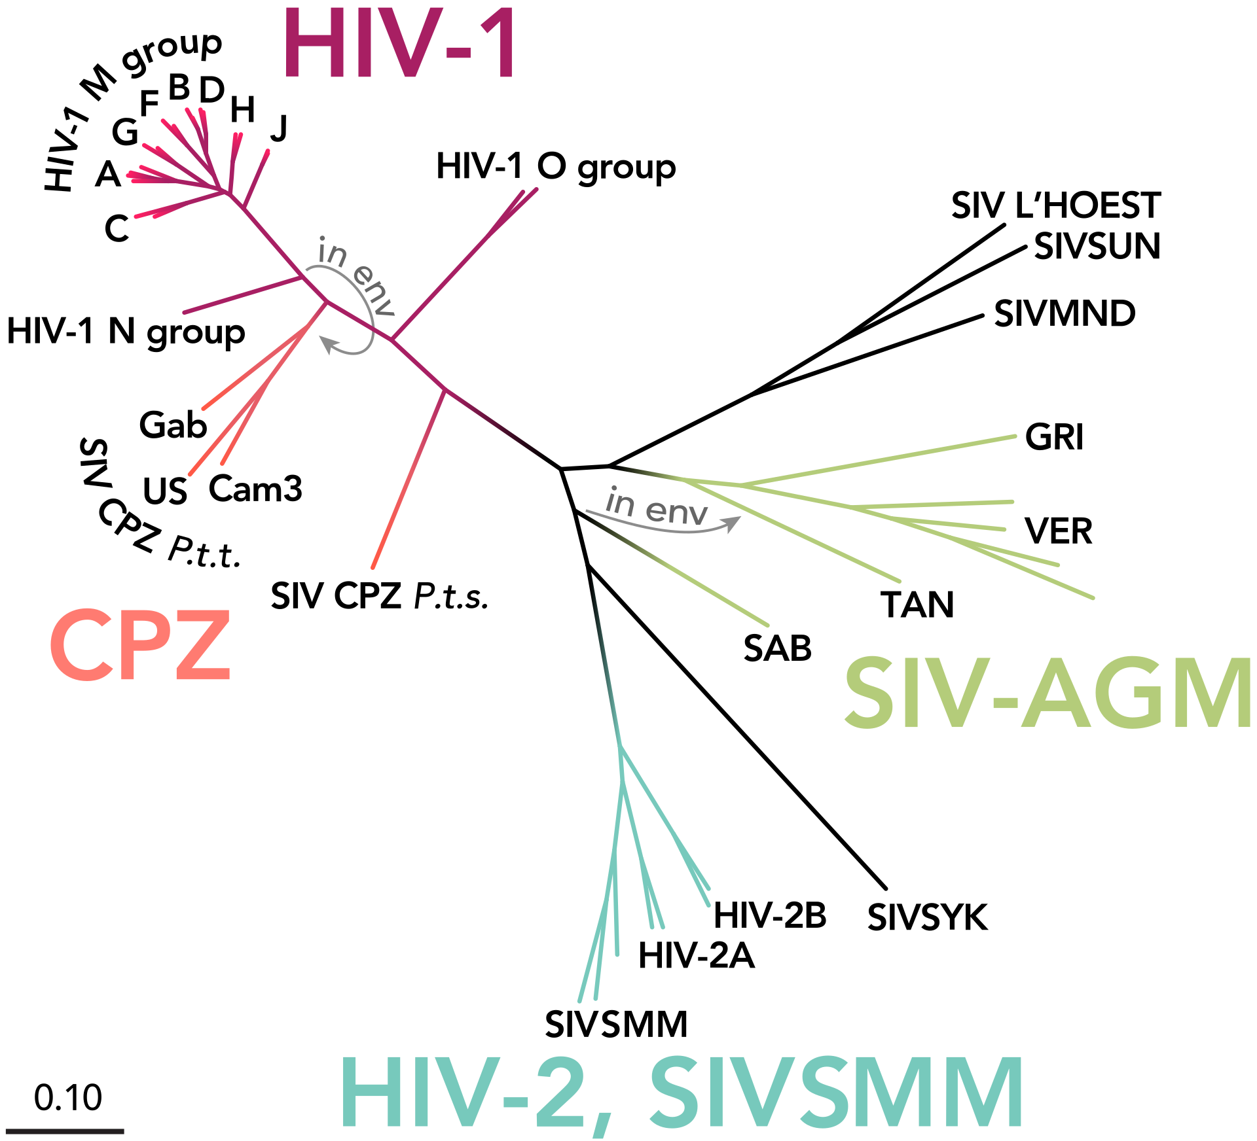
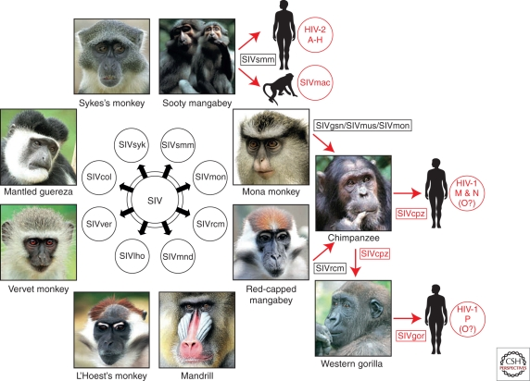
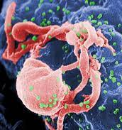
Most stage V pathogens once had an animal origin, as well!
Stage V
Transmits exclusively in humans
HIV
Sharp & Hahn. 2011. Cold Spring Harb Perspect Med.

Slide 21
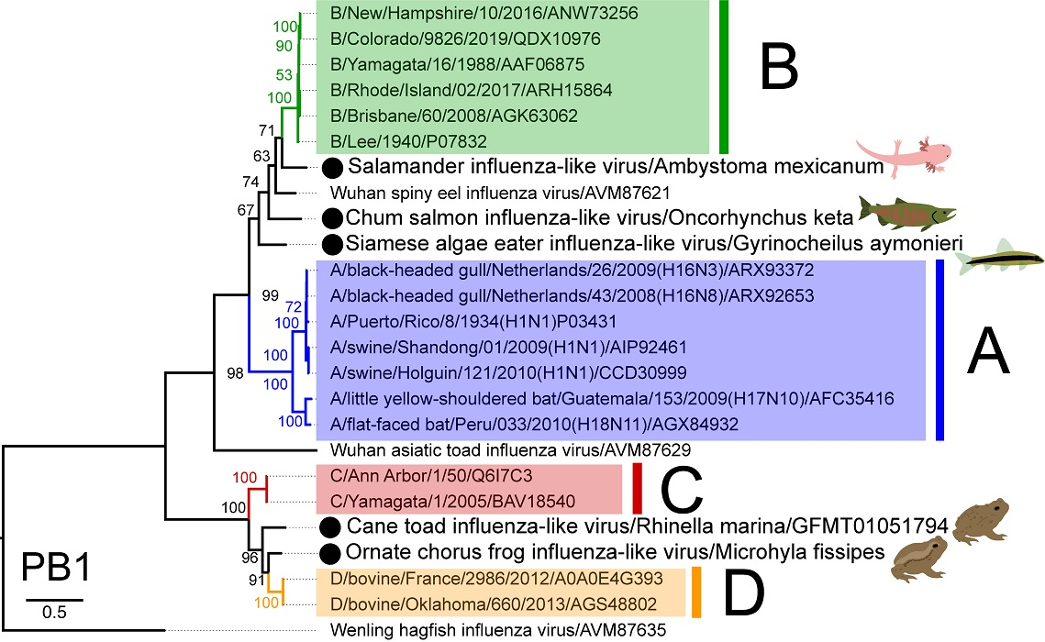
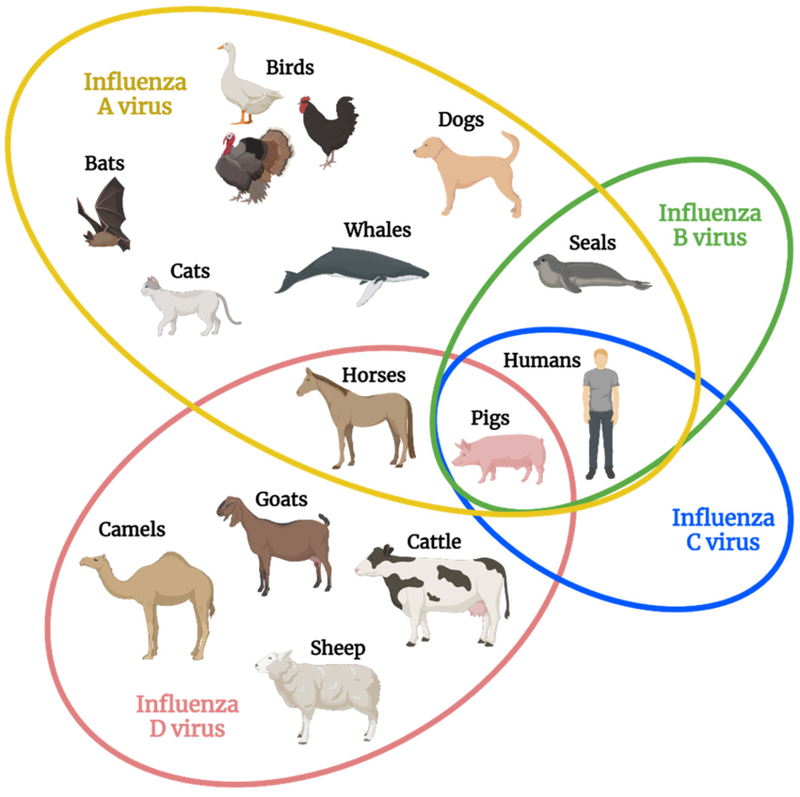
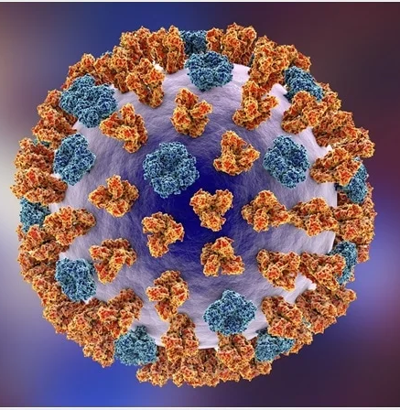
Most stage V pathogens once had an animal origin, as well!
Parry et al. 2020. Viruses.
Transmits exclusively in humans
Stage V
Influenza
Skelton & Huber. 2022. Viruses.

Slide 22
Modeling zoonotic pathogens typically necessitates modeling epidemic dynamics in multiple host populations.
Plague has added complexity as a vector-borne pathogen!

Slide 23
Modeling zoonotic pathogens typically necessitates modeling epidemic dynamics in multiple host populations.
Plague has added complexity as a vector-borne pathogen!

Slide 24
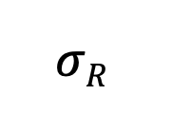
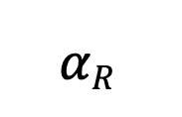
Modeling zoonotic pathogens typically necessitates modeling epidemic dynamics in multiple host populations.
Plague has added complexity as a vector-borne pathogen!
μ_{R}
μ_{R}
$$αR$$
b_{R}
β_{R}
$$σR$$
μ_{R}
S_{R}
I_{R}
R_{R}
Rat reservoir dynamics
b_{F}
S_{F}
β_{F}
I_{FR}
Rats get infected from contact with infectious fleas. Fleas get infected from contact with infectious rats.
μ_{F}
μ_{F}

Slide 25

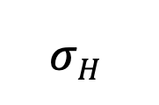
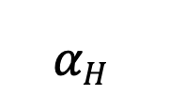
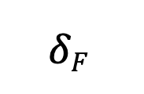
Modeling zoonotic pathogens typically necessitates modeling epidemic dynamics in multiple host populations.
Plague has added complexity as a vector-borne pathogen!
μ_{R}
μ_{R}
$$αR$$
b_{R}
β_{R}
$$σR$$
μ_{R}
S_{R}
I_{R}
R_{R}
b_{F}
S_{F}
β_{F}
I_{FR}
$$δF$$
I_{FF}
μ_{F}
μ_{F}
μ_{F}
Humans get infected from contact with free-living infectious fleas!
b_{H}
β_{H}
$$σH$$
μ_{H}
S_{H}
I_{H}
R_{H}
$$αH$$
μ_{H}
μ_{H}

Slide 26
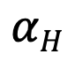
Modeling zoonotic pathogens typically necessitates modeling epidemic dynamics in multiple host populations.
Plague has added complexity as a vector-borne pathogen!
μ_{R}
μ_{R}
$$αR$$
b_{R}
β_{R}
$$σR$$
μ_{R}
S_{R}
I_{R}
R_{R}
How many equations would we need to model this system?
b_{F}
S_{F}
β_{F}
I_{FR}
$$δF$$
I_{FF}
μ_{F}
μ_{F}
μ_{F}
μ_{H}
b_{H}
β_{H}
$$σH$$
μ_{H}
S_{H}
I_{H}
R_{H}
$$αH$$
μ_{H}

Slide 27
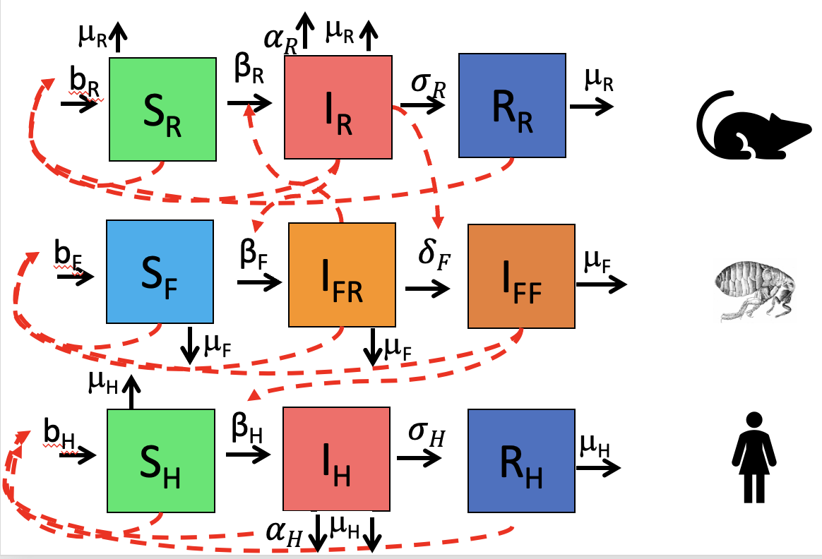

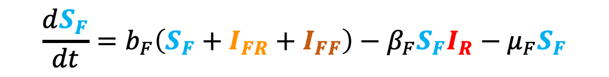

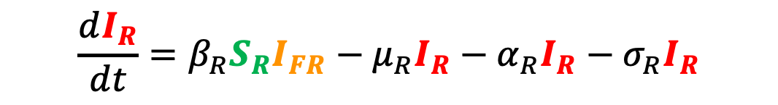

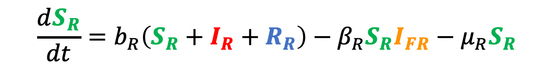
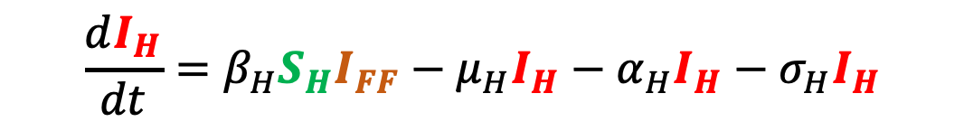

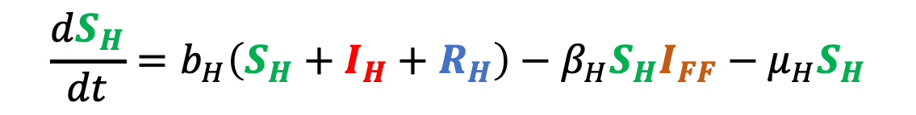
$$\frac{dS_{R}}{dt}=b_{R}\left(S_{R}+I_{R}+R_{R}\right)−β_{R}S_{R}I_{FR}−μ_{R}S_{R}$$
A simple plague model
$$\frac{dI_{R}}{dt}=β_{R}S_{R}I_{FR}−μ_{R}I_{R}−α_{R}I_{R}−σ_{R}I_{R}$$
Rats
$$\frac{dR_{R}}{dt}=σ_{R}I_{R}−μ_{R}R_{R}$$
$$\frac{dS_{F}}{dt}=b_{F}\left(S_{F}+I_{FR}+I_{FF}\right)−β_{F}S_{F}I_{R}−μ_{F}S_{F}$$
$$\frac{dI_{FR}}{dt}=β_{F}S_{F}I_{R}−δI_{FR}−μ_{F}I_{FR}$$
Fleas
$$\frac{dI_{FF}}{dt}=δI_{FR}{−μ}_{F}I_{FF}$$
$$\frac{dS_{H}}{dt}=b_{H}\left(S_{H}+I_{H}+R_{H}\right)−β_{H}S_{H}I_{FF}−μ_{H}S_{H}$$
$$\frac{dI_{H}}{dt}=β_{H}S_{H}I_{FF}−μ_{H}I_{H}−α_{H}I_{H}−σ_{H}I_{H}$$
Humans
$$\frac{dR_{H}}{dt}=σ_{H}I_{H}−μ_{H}R_{H}$$

Slide 28
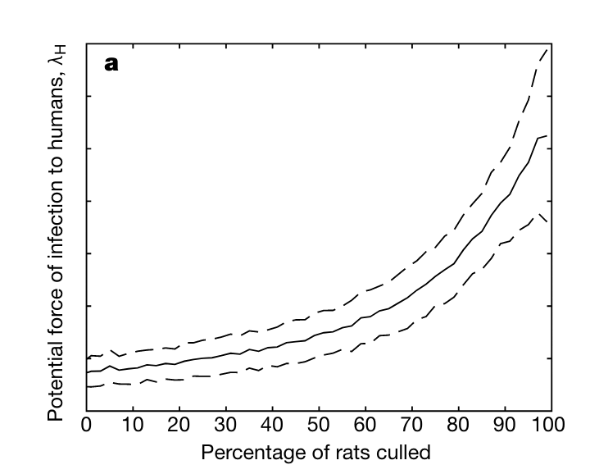
Fleas get infected from rats.
Humans get infected from free-living infected fleas!
“…from April 18 onwards, quantities of dead or dying rats were found in factories and warehouses…From the outer suburbs to the center of the town, in all the byways where the doctor's duties took him, in every thoroughfare, rats were piled up in garbage cans or lying in long lines in the gutters…On the fourth day the rats began to come out and die in batches…”
--La Peste, Albert Camus (1948)
Keeling and Gilligan. 2000. Nature.

Slide 29
Humans get infected from free-living infected fleas!
“…from April 18 onwards, quantities of dead or dying rats were found in factories and warehouses…From the outer suburbs to the center of the town, in all the byways where the doctor's duties took him, in every thoroughfare, rats were piled up in garbage cans or lying in long lines in the gutters…On the fourth day the rats began to come out and die in batches…”
--La Peste, Albert Camus (1948)
Keeling and Gilligan. 2000. Nature.

Slide 30
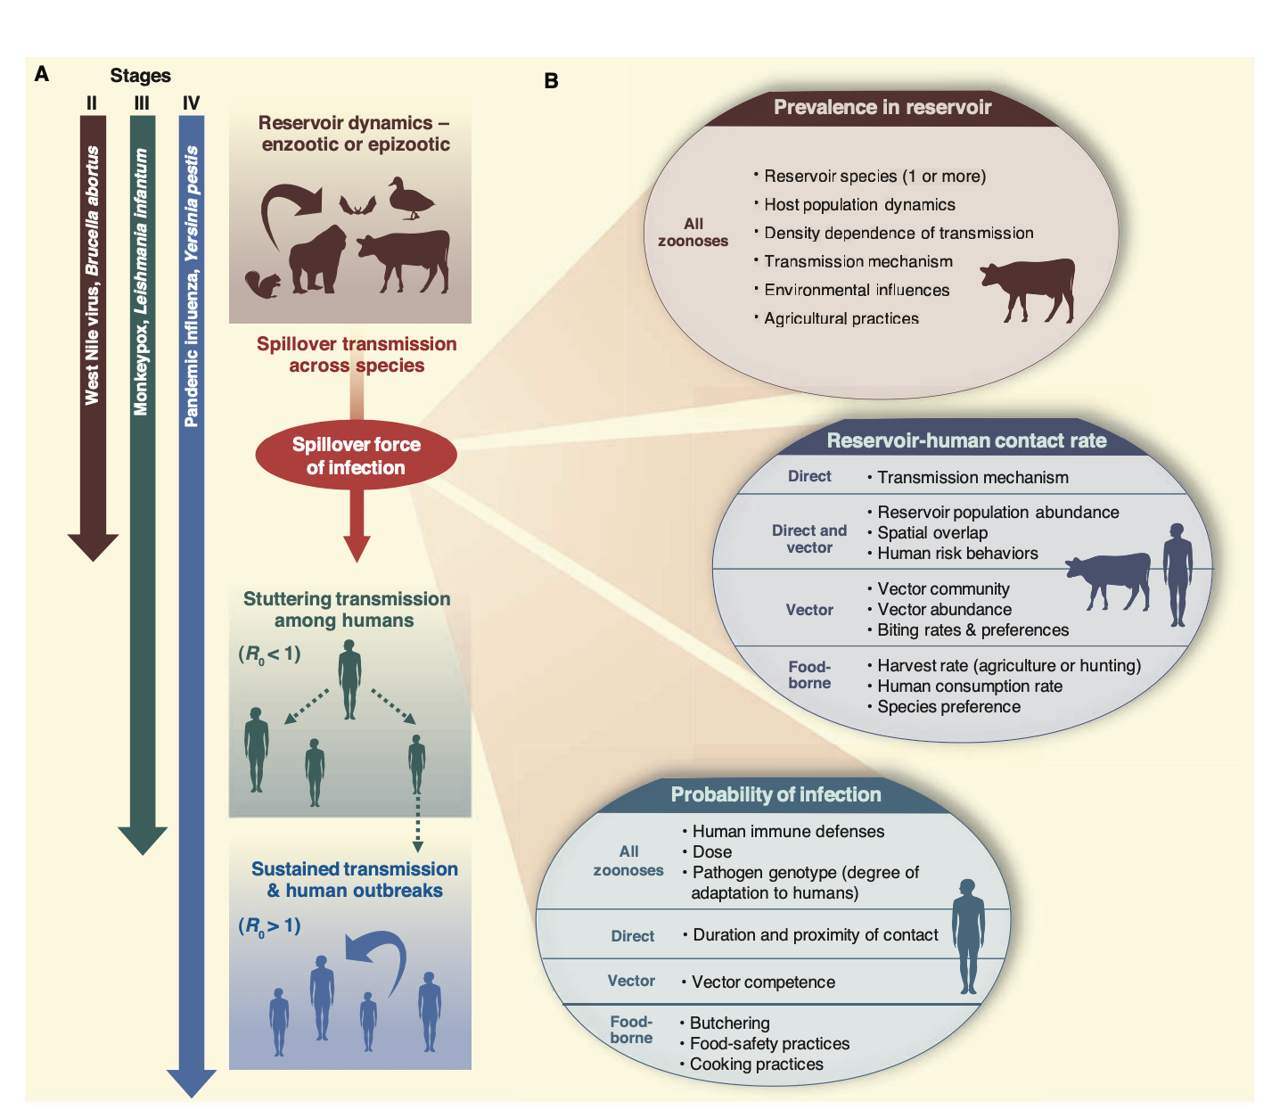
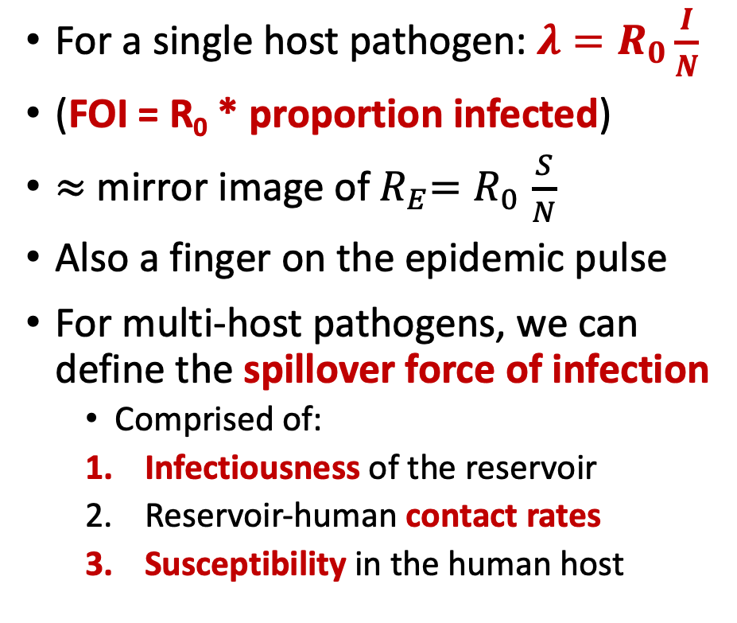
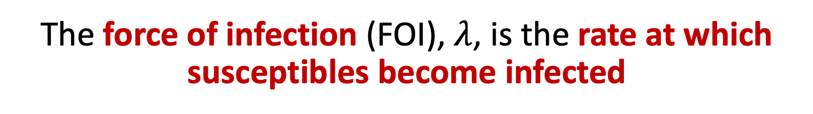
The force of infection (FOI), $λ$, is the rate at which susceptibles become infected
For a single host pathogen: ${λ=R}_{0}\frac{I}{N}$
(FOI = R₀ * proportion infected)
$≈$ mirror image of${ R}_{E}{=R}_{0}\frac{S}{N}$
Also a finger on the epidemic pulse
For multi-host pathogens, we can define the spillover force of infection
Comprised of:
Infectiousness of the reservoir
Reservoir-human contact rates
Susceptibility in the human host
Lloyd-Smith et al. 2009. Science.

Slide 31
The force of infection (FOI), $λ$, is the rate at which susceptibles become infected
For a single host pathogen: ${λ=R}_{0}\frac{I}{N}$
(FOI = R₀ * proportion infected)
$≈$ mirror image of${ R}_{E}{=R}_{0}\frac{S}{N}$
Also a finger on the epidemic pulse
For multi-host pathogens, we can define the spillover force of infection
Comprised of:
Infectiousness of the reservoir
Reservoir-human contact rates
Susceptibility in the human host
Lloyd-Smith et al. 2009. Science.

Slide 32
The force of infection (FOI), $λ$, is the rate at which susceptibles become infected
For a single host pathogen: ${λ=R}_{0}\frac{I}{N}$
(FOI = R₀ * proportion infected)
$≈$ mirror image of${ R}_{E}{=R}_{0}\frac{S}{N}$
Also a finger on the epidemic pulse
For multi-host pathogens, we can define the spillover force of infection
Comprised of:
Infectiousness of the reservoir
Reservoir-human contact rates
Susceptibility in the human host
Lloyd-Smith et al. 2009. Science.

Slide 33
The force of infection (FOI), $λ$, is the rate at which susceptibles become infected
For a single host pathogen: ${λ=R}_{0}\frac{I}{N}$
(FOI = R₀ * proportion infected)
$≈$ mirror image of${ R}_{E}{=R}_{0}\frac{S}{N}$
Also a finger on the epidemic pulse
For multi-host pathogens, we can define the spillover force of infection
Comprised of:
Infectiousness of the reservoir
Reservoir-human contact rates
Susceptibility in the human host
Lloyd-Smith et al. 2009. Science.

Slide 34
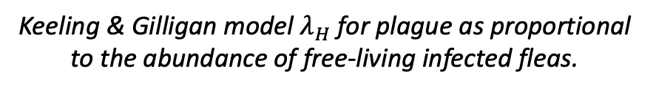
The force of infection (FOI), $λ$, is the rate at which susceptibles become infected
For a single host pathogen: ${λ=R}_{0}\frac{I}{N}$
(FOI = R₀ * proportion infected)
$≈$ mirror image of${ R}_{E}{=R}_{0}\frac{S}{N}$
Also a finger on the epidemic pulse
For multi-host pathogens, we can define the spillover force of infection
Comprised of:
Infectiousness of the reservoir
Reservoir-human contact rates
Susceptibility in the human host
Keeling & Gilligan model $λ_{H}$ for plague as proportional to the abundance of free-living infected fleas.
Lloyd-Smith et al. 2009. Science.

Slide 35
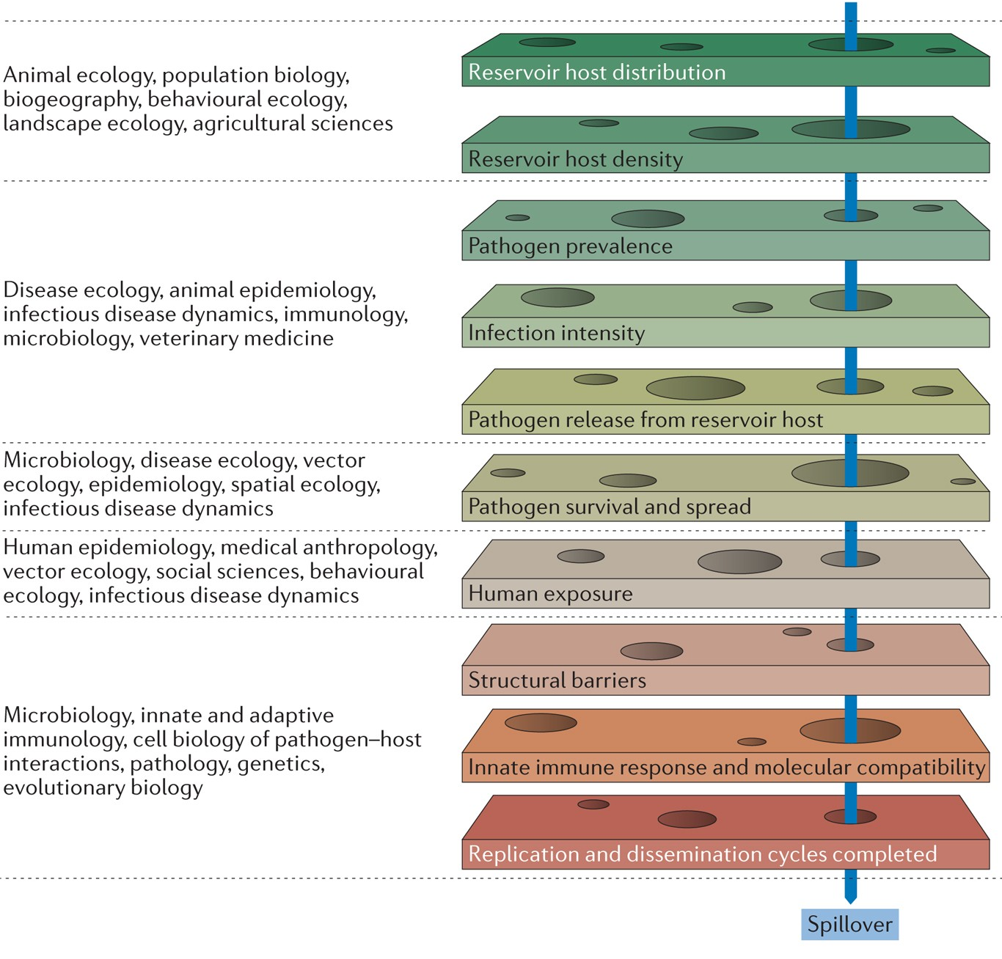
Zoonosis is a series of improbable events.
Plowright et al. 2017. Nature Reviews Microbiology.

Slide 36
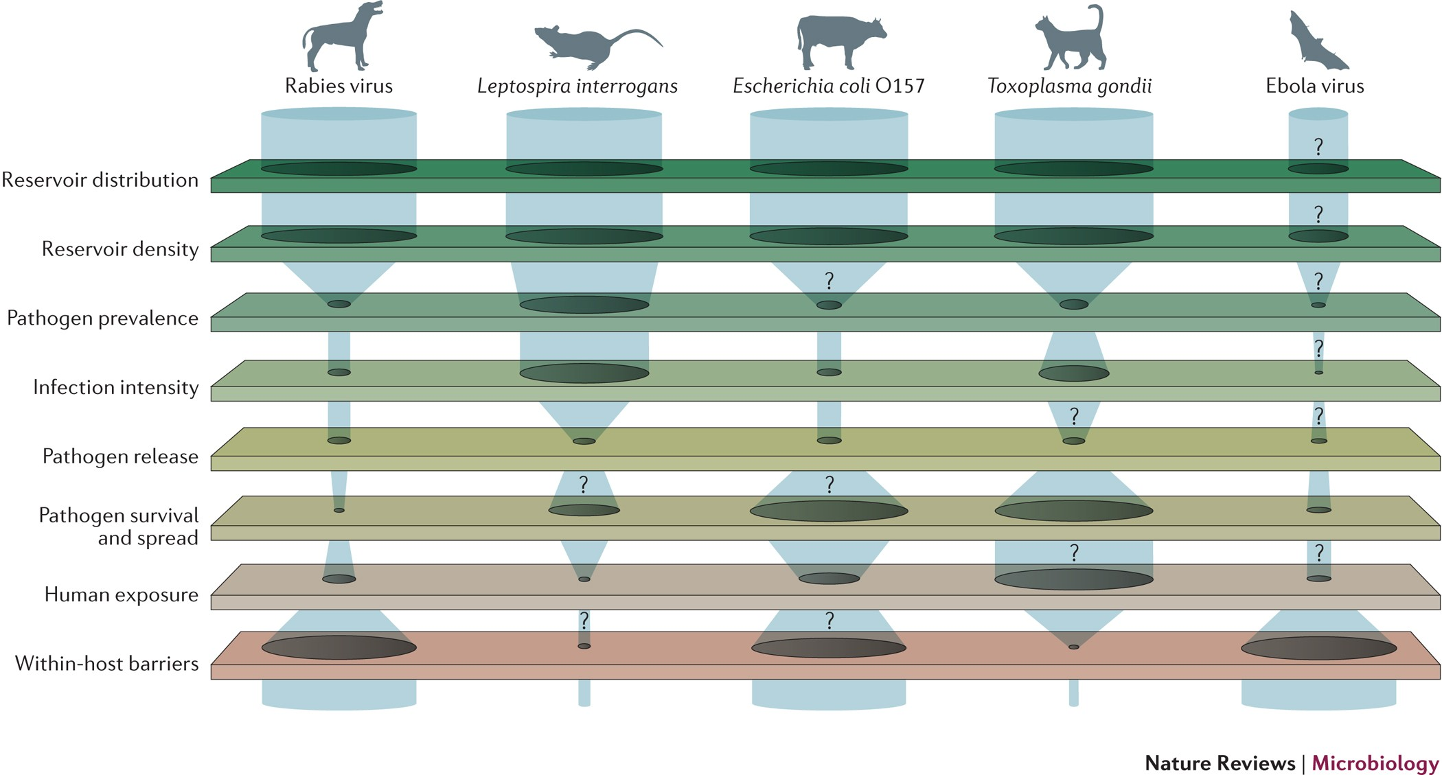
Bottlenecks to spillover.
Plowright et al. 2017. Nature Reviews Microbiology.

